Slide 1
A World of Marketing Opportunities 2021
Presented by Cillest Pieters

Slide 2
CLUB OVERVIEW
Clubhouse with bar & restaurant
Pro Shop
Halfway House
18 hole course
Variety of family- and business-friendly facilities: Jump4Joy Trampoline Park/Adventure Golf Putt Putt/Women in Wellness SPA/ Kabohamo Auto Moto – licensing

Slide 3
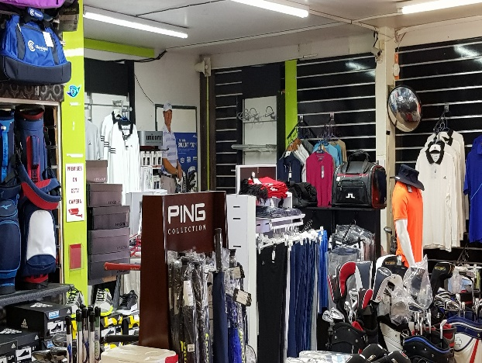
OUR FACILITIES
Golf
Halfway House
Pro-shop
Bar & Restaurant
18 hole golf course
Refreshments & grab and go
Golf gear & repairs
Delicious food & alcohol
Golf Clinics
Junior clinics

Slide 4
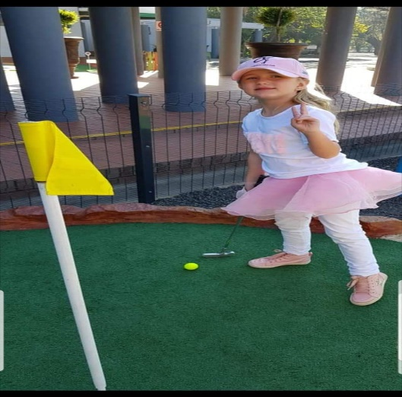
OUR FACILITIES
Venue Hire
Golf Days (example)
Mini Golf
Kids Parties
details
details
Kids Adventure
PUTT PUTT

Slide 5
SPECIAL FACILITIES
Conferences
Parties
Team Building example
Coffee Shop
details
details
details
details

Slide 6
SPECIAL EVENTS
Market Day
Sunday Buffet
Weddings
Run&Walk for life
details
details
details
details

Slide 7
MARKETING OPPORTUNITIES
Signage on Tee Boxes
Signage at Putt-Putt
Corporate Memberships
Golf Days
Branding of Golf Carts
Sponsorships
Social Media

Slide 8
MARKETING PACKAGES
Bronze R35 000
Silver R40 000
Chrome R45 000
Gold R50 000
Nickel R55 000
Platinum R60 000

Slide 9
MARKETING PACKAGES
PLAN FEATURES
Tee to Green Hole Sponsors |  | R2000 – 5000
Social Media |  | R2000
Advertisement at passage to Pro Shop |  | R1000
Golf Carts |  | R550
Signage Boards Putt Putt |  | R1000

